Slide 1
FIFA Player Analysis & Value Prediction
Motivation & Methods
Motivation
Data Overview
Data Cleaning
Exploratory Data Analysis
Modeling
Model Selection & Feature Selection
Hypothesis Testing
Rumi A. Allbert
Results
Model Improvements and results

Slide 2

Outline
Motivation & Methods
Motivation
Data Overview
Data Cleaning
Exploratory Data Analysis
Modeling
Model Selection & Feature Selection
Hypothesis Testing
Results
Model Improvements and results

Slide 3
Motivation
WC currently taking place
Interested in what makes a ‘great’ and ‘valued’ soccer player.
Goal
Use of linear regression to predict player value given player features.
Use of regression methods and diagnostics to build a model free of heteroskedasticity.
Use different techniques and tests to determine feature importance.

Slide 4
Data Overview
Observations: 19,239
Including both female and male players.
Features: 110
Many are useless:
Name of player
Player ID
Sample of features:
Player position
Overall (score)
Potential (score)
Player value
Wage
Age
Height
Weight
Nationality

Slide 5
Preliminary Cleaning
Remove Unnecessary Columns:
Player name
DOB
Player tags
Player traits
Player URL
Club logo
Club flag
Nation logo
Nation flag

Slide 6
Preliminary Cleaning
Remove Unnecessary Columns
2. Simplify Columns
Group player positions into either:
Defense
Offense
Midfield
Simplify Club association:
1 if player is in top 15 clubs, 0 otherwise.
Change Boolean values to 0 or 1
feature | Missing
jersey_number | 18480
nation_logo_url | 18480
nation_position | 18480
nation_team_id | 18480
club_loaned_from | 18137
player_tags | 17798
goalkeeping_speed | 17107
player_traits | 9841
dribbling | 2132
shooting | 2132

Slide 7
Preliminary Cleaning
Remove Unnecessary Columns
2. Simplify Columns
feature | Missing
jersey_number | 18480
nation_logo_url | 18480
nation_position | 18480
nation_team_id | 18480
club_loaned_from | 18137
player_tags | 17798
goalkeeping_speed | 17107
player_traits | 9841
dribbling | 2132
shooting | 2132
Impute or Drop empty Columns
Many columns are very sparse and contain many missing values. We can drop these as they won’t provide much predictive power.

Slide 8
Preliminary Cleaning
Remove Unnecessary Columns
2. Simplify Columns
feature | Missing
jersey_number | 18480
nation_logo_url | 18480
nation_position | 18480
nation_team_id | 18480
club_loaned_from | 18137
player_tags | 17798
goalkeeping_speed | 17107
player_traits | 9841
dribbling | 2132
shooting | 2132
Impute or Drop empty Columns
New dataset:
62 columns
Will need to see which are actually important!

Slide 9
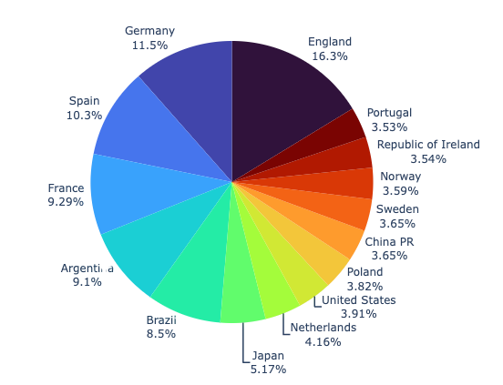
Exploratory Data Analysis
Where are most players from?
Who is the player with maximum potential? And who is maximum overall?
Who is the most expensive player? And which player is valued the highest?
Are there any linear relationships we can quickly explore?

Slide 10
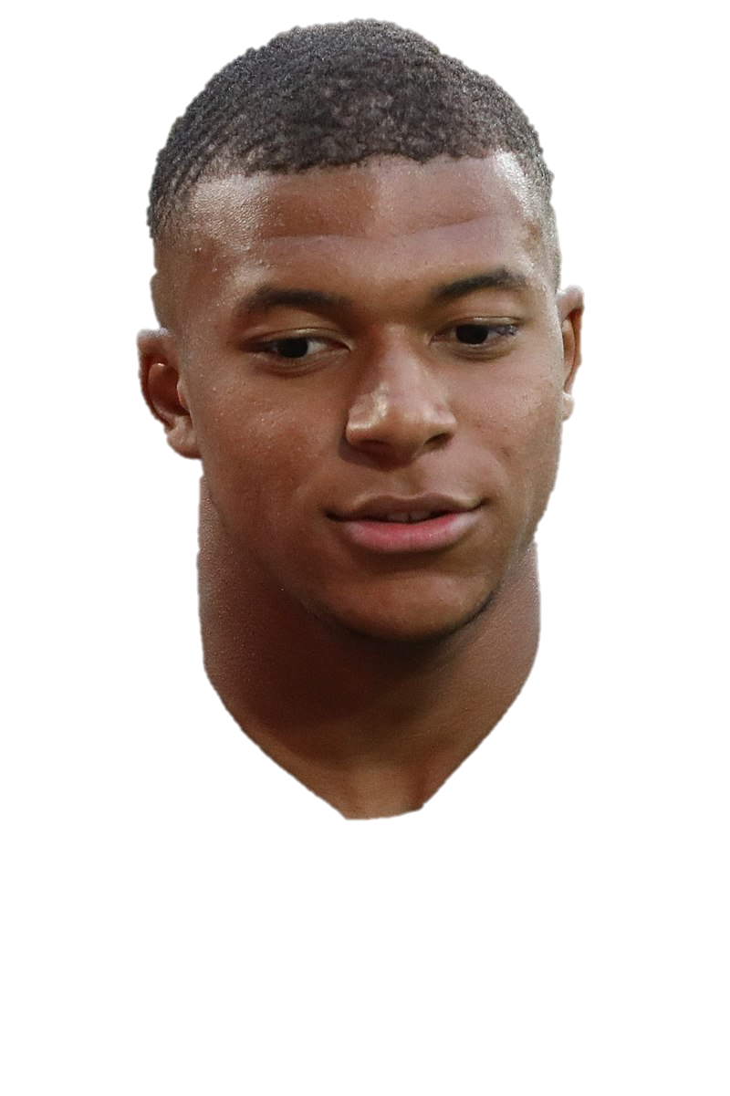

Exploratory Data Analysis
Where are most players from?
£194m
Most players are from Europe or Latin America.
£78m
Who is the player with maximum potential? And who is maximum overall?
Who is the most expensive player? And which player is valued the highest?
Are there any linear relationships we can quickly explore?

Slide 11
Exploratory Data Analysis
Where are most players from?
Who is the player with maximum potential? And who is maximum overall?
Maximum Potential: Kylian Lottin
Maximum Overall: Lionel Messi
95
93
Who is the most expensive player? And which player is valued the highest?
Are there any linear relationships we can quickly explore?

Slide 12
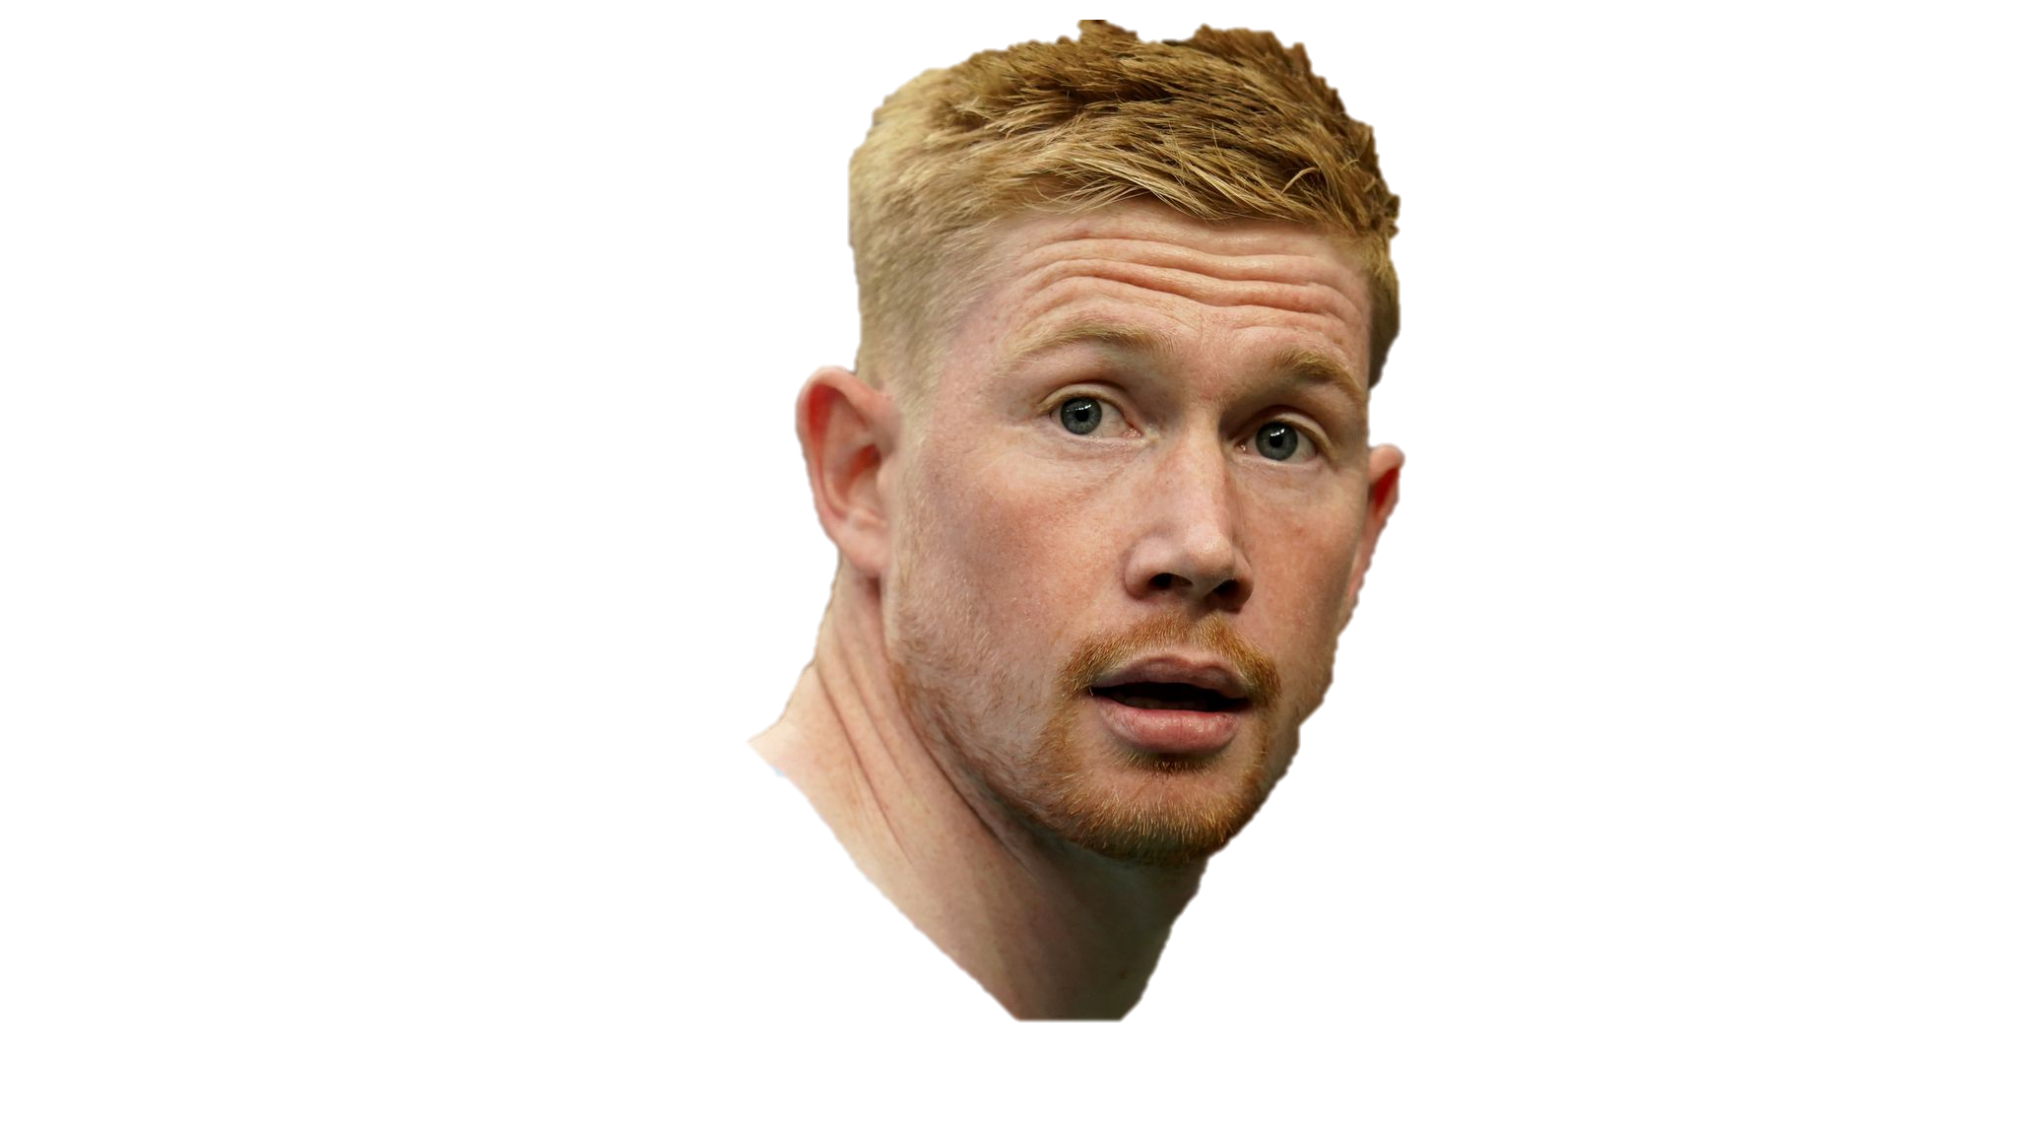
Exploratory Data Analysis
Who is the player with maximum potential? And who is maximum overall?
Who is the most expensive player? And which player is valued the highest?
Most Expensive Player: Kevin De Bruyne
£350,000
Are there any linear relationships we can quickly explore?

Slide 13
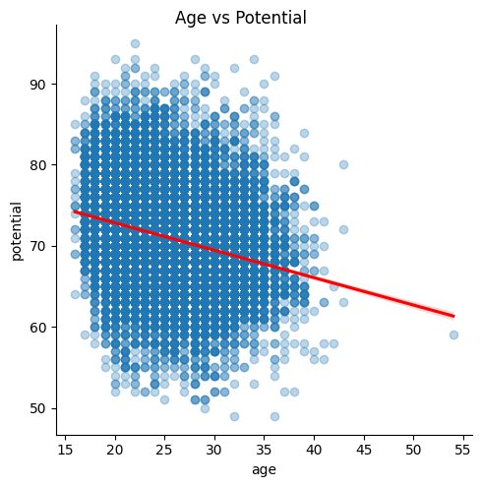
Exploratory Data Analysis
Who is the player with maximum potential? And who is maximum overall?
Who is the most expensive player? And which player is valued the highest?
Most Valued Player: Kylian Lottin
£194m
Are there any linear relationships we can quickly explore?

Slide 14
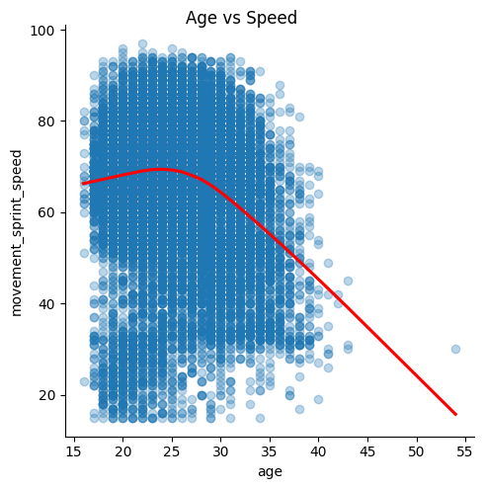
Exploratory Data Analysis
Who is the most expensive player? And which player is valued the highest?
Are there any linear relationships we can quickly explore?
-0.26

Slide 15
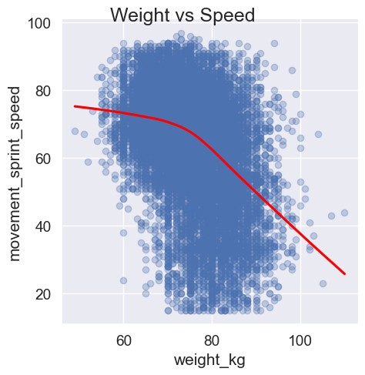
Exploratory Data Analysis
Who is the most expensive player? And which player is valued the highest?
Are there any linear relationships we can quickly explore?
-0.139

Slide 16
Exploratory Data Analysis
Who is the most expensive player? And which player is valued the highest?
Are there any linear relationships we can quickly explore?
-0.4

Slide 17
Modeling

Slide 18
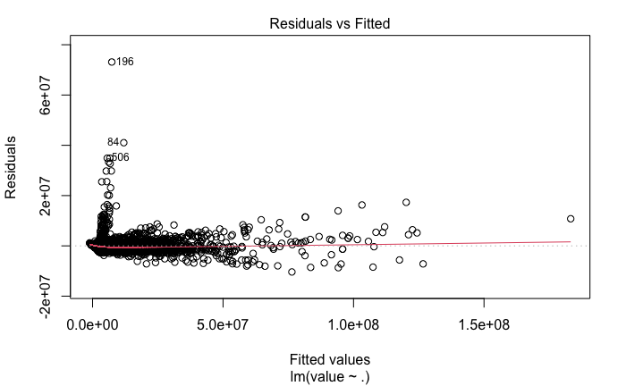
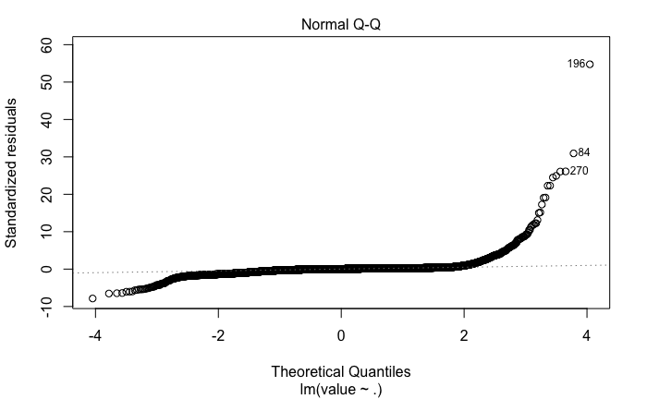
Full Model
1
Remove features
Residual Error: 1342000
2
Apply transformation to label
R-squared: 0.96
Adj R-squared: 0.96
3
Eliminate Outliers

Slide 19
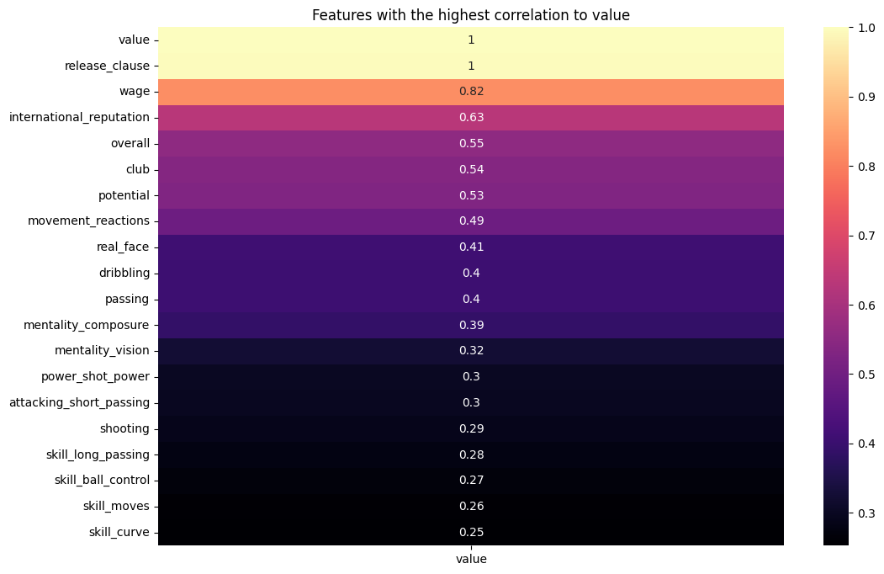
Model Selection
Residual Error: 1342000
R-squared: 0.96
Adj R-squared: 0.96
1
Remove features
2
Apply transformation to label
3
Eliminate Outliers

Slide 20
1
Remove features
1. Check which features have the highest correlation with player value
2
Apply transformation to label
3
Eliminate Outliers

Slide 21
1
Remove features
2. Perform feature selection:
- Backward Elimination
- Forward Selection
- Stepwise Regression
2
Apply transformation to label
3
Eliminate Outliers

Slide 22
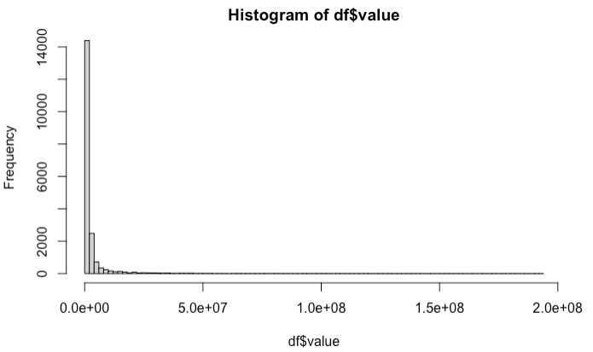
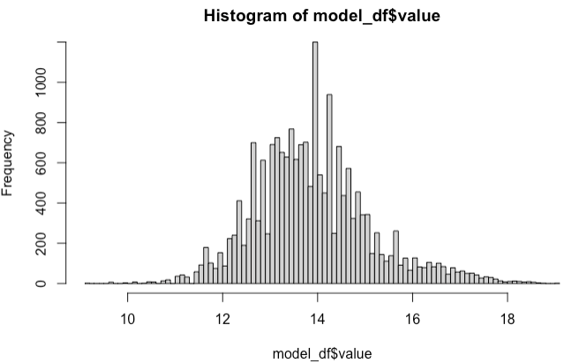
2
Apply transformation to label
1
Remove features
Stepwise Regression AIC
Residual Error: 1340910.089
R-squared: 0.969
Lower R-squared, but down to 19 features from 62

Slide 23
3
Eliminate Outliers
2
Apply transformation to label
Apply Box Cox transformation on player value

Slide 24
3
Eliminate Outliers
2
Apply transformation to label
Apply Box Cox transformation on player value
+ Additional Stepwise Regression
Residual Error: 0.2531
R-squared: 0.958

Slide 25
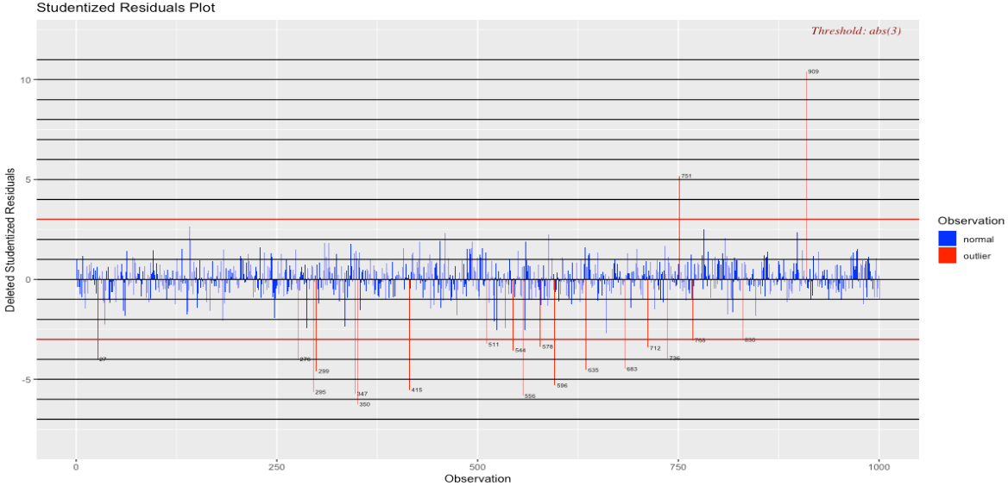
2
Apply transformation to label
3
Eliminate Outliers

Slide 26
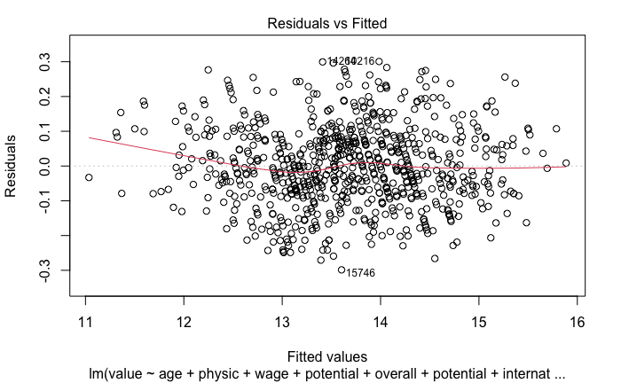
3
✅
Final Model
lm(formula = value ~ age + physic + wage + potential + overall + international_reputation)
Residual Error: 0.1151
R-squared: 0.9815

Slide 27
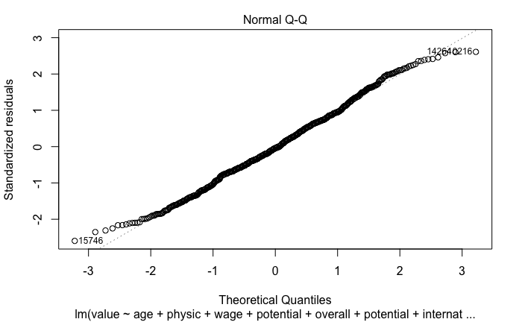
Final Model Diagnostic
✅
Residual Error: 0.1151
R-squared: 0.9815

Slide 28
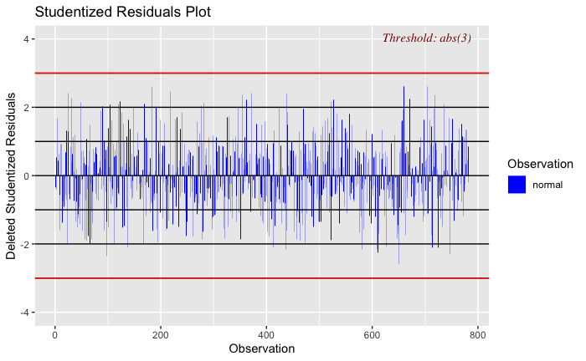
Final Model Diagnostic
✅
Residual Error: 0.1151
R-squared: 0.9815

Slide 29
Final Model Diagnostic
✅
Residual Error: 0.1151
R-squared: 0.9815

Slide 30
✅
Questions?
Residual Error: 0.1151
R-squared: 0.9815

